Slide 1
IBM BPM Admin Tools
Juan Camilo Parra
IBM Cloud Consultant
jcparra@co.ibm.com

Slide 2
IBM BPM Admin Tools
User Guide

Slide 3
Overview
BPMAdminTool is a set of helping tools intent to make easier the administration of IBM BPM version 8.0.3 or upper.
It was created based on 5 years experience with customer on Latin America, knowing their principals administration issues, extending functionality about most typical administrative tasks.
Use this tools at your own risk.

Slide 4
Configure Before Use
Please follow Installation and configuration guide to be able to work with this tools, if some parameters are misconfigured, some functionalities can not work as expected

Slide 5
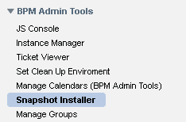
Snapshot Installer
This tool is basically a way to export and install snapshots using an user interface.

Slide 6
Mode of Use
This tool has two mode of use, on Process Center, you can export a Snapshot on a specific directory, but on Process Server you can import it.
Export is useful on version that has to be exported by command line, because they not have download options (like 8.5.5 or upper)
You can delegate a user to perform this task without given him a tw_admins user
On a cluster environment you can make a shared folder to export import path.

Slide 7
Authorization
To access this tool you have to be member of BPMAdmin_Snapshot_Installer
This tools works using wsadmin to install or export Snapshots

Slide 8
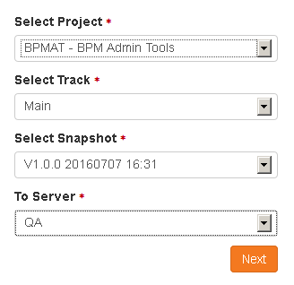
Export (Process Center)
Select Project, Track, Snapshot and Server to Install.
On PC 8.5.5 or upper version, please use Process Center.
Click on Next and wait for your Ticket ID.
That Track ID can be use on Ticket Viewer Tool.

Slide 9
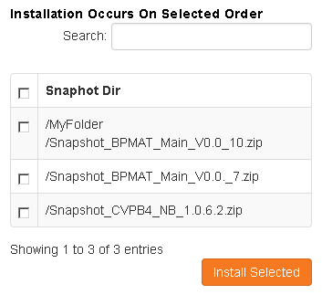
Import (Process Server)
Select Snapshots to install on Installation Order.
This view is recursive on folders
You can filter by a search
Click on Install and wait for your Ticket ID.
That Track ID can be use on Ticket Viewer Tool.

Slide 10
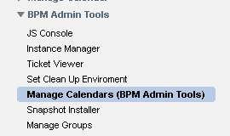
Manage Calendar
This tool is a re write Manage Calendar build or published on wiki by Gordon Siegfriedt, I take the concept from him.

Slide 11
Mode of Use
This tool allow user to modify Holidays and Time Schedule on BPM.
Please be careful about delete a Time Schedule or Holiday Calendar on BPM.
Remember IBM BPM doesn´t recalculate dates with modifications of this parameters, instead use it with new calculations.

Slide 12
Authorization
To access this tool you have to be member of BPMAdmin_Calendar_Manager

Slide 13
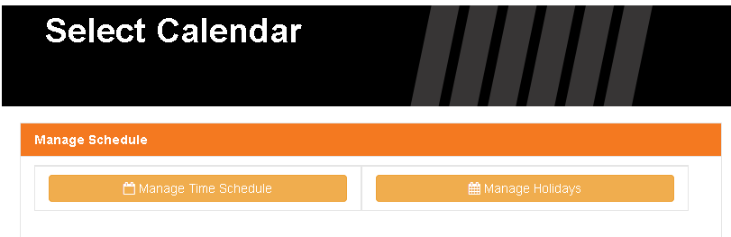
Principal Page
Here you can select between Manage Time Schedule and Manage Holidays

Slide 14
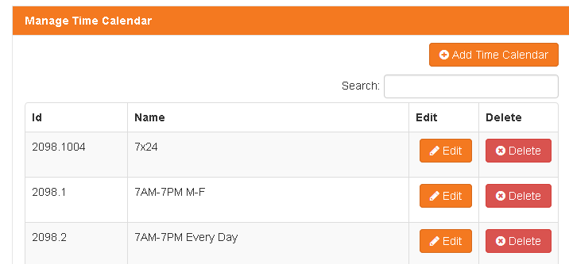
Manage Time Schedule
You can Add a new Time Calendar, modify one or remove

Slide 15
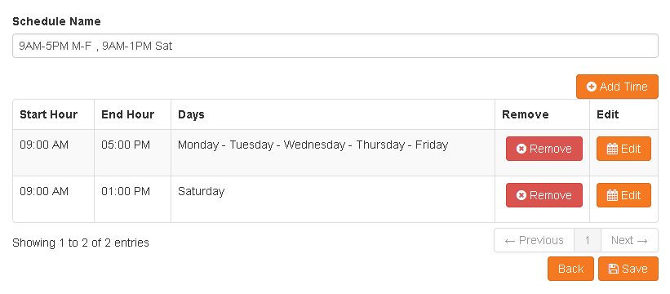
Manage Time Schedule
Modify one is very simple and intuitive

Slide 16
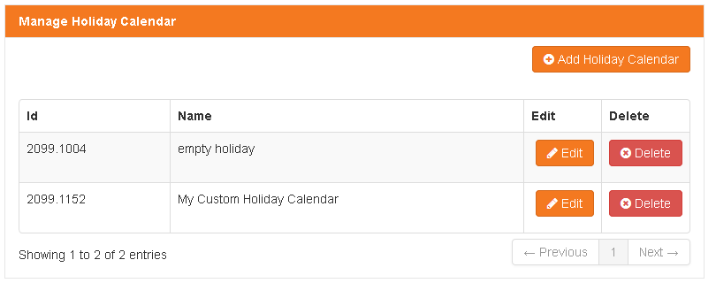
Manage Holidays
You can Add a new Holiday Calendar, modify one or remove.

Slide 17
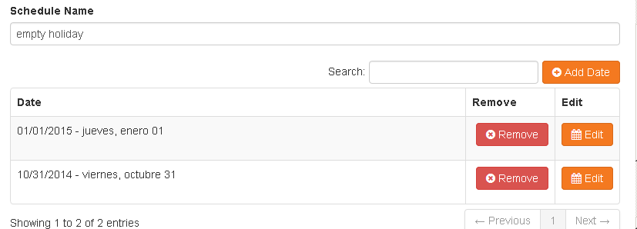
Manage Holidays
Edit and add dates is easy.
Date format can be configured with EV and work with user locale.

Slide 18
Manage Groups
Allow to modify IBM BPM groups, (add or remove users)

Slide 19
Mode of Use
There is no way to use product group manager tool without to be a tw_admins and there is some cases that an area is the responsible to manage users and groups, but not the administrator of platform.
You can bulk data this is very interesting thing when you have to perform a lot of actions with groups.

Slide 20
Authorization
To access this tool you have to be member of BPMAdmin_Manage_Groups
The person on this group can modify all groups inside BPM except those one inside BPMAdmin_Manage_Groups_Excluded on this way if group tw_admins is member of BPMAdmin_Manage_Groups_Excluded, the user cannot modify tw_admins, it works nested groups too.
By default user cannot modify tw_admins and tw_process_owners, and there is no way user can modify tw_all_users

Slide 21
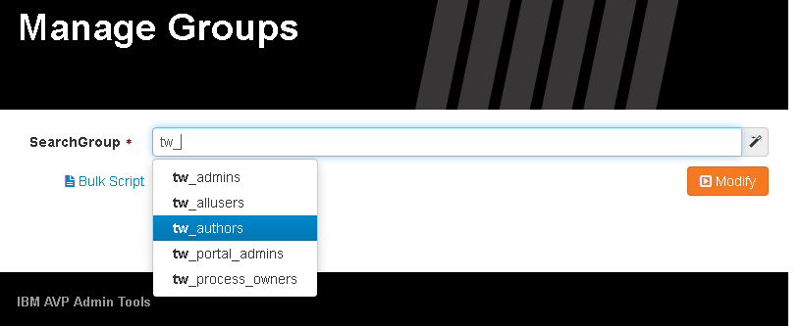
Modify a Group
You can to use UI to change groups, just you have to write some characters to select group to change, and click modify

Slide 22
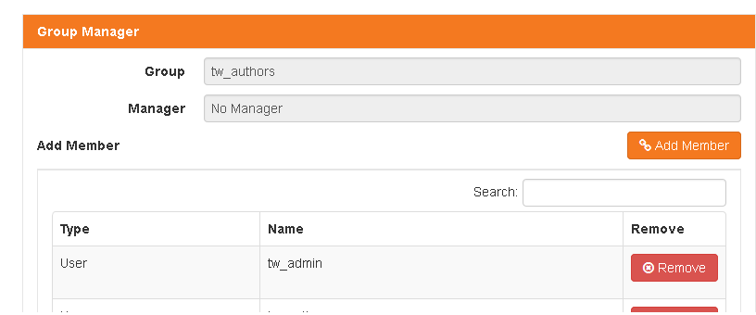
Add or Remove Members
You can add or remove members and groups from this group

Slide 23
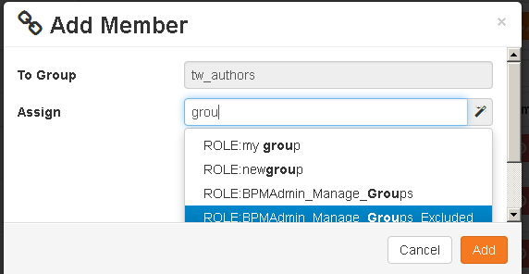
Add or Remove Members
If you can’t find a user with autocomplete, add it directly, example «tw_admin» and click add, it will refresh user from ldap and you can see it after that.

Slide 24
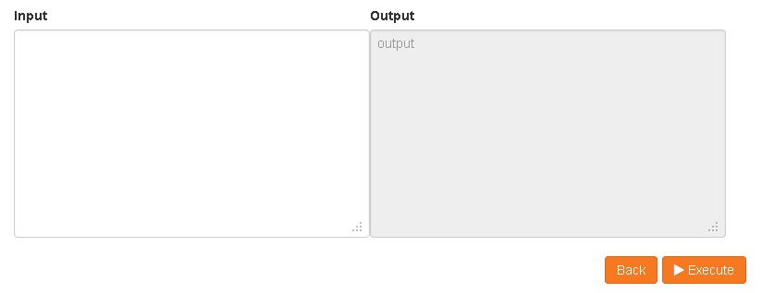
Modify By Script
Click on Bulk Script and paste your script on left side

Slide 25
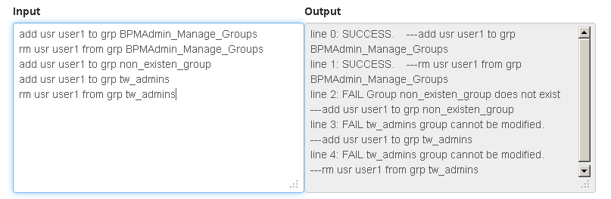
Modify By Script
Script is very simple just follow this simple rule
< add | rm > < grp | usr > childName < from | to > grp parentName

Slide 26
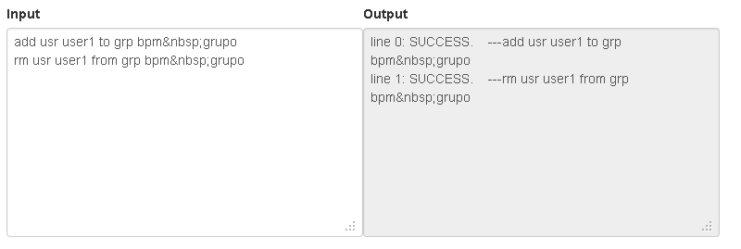
Modify By Script
If you need to use a group name with spaces just use html character &nbsp; instead of

Slide 27
Instance Manager
This tool is a little Process Inspector, that allows to check instances, states, failed, retry, etc. usefull when process server is on offline mode.

Slide 28
Mode of Use
It works on a complex way, because you can allow some person to access just a single process app, you can reassign a single task or view the BPD business object, but all of this functions has differents privileges to be performed.
(Deprecated on 8.5.6 or Upper, use Process Inspector instead, at least you only require Read Instance access)
I want to thank Sergio Gutierrez, it was a mutual idea, he performed the first approach of this, and now it is a complex and usefull Instance Manager.

Slide 29
Authorization
To access this tool you have to be member of BPMAdmin_Instance_Viewer, is required by all members that has to access this console.
BPMAdmin_BO_Viewer is a rol to access BPD level Business Object, people that have this privilege can see the BPD Business Object
BPMAdmin_Reassigner is a rol that allow to reassign active task on instance.
No roles can access any project by default, the authorization has to be given user by user, only the BPMAdmin_Project_Inspector_Admin can modify this authorization, please refer Giving Access To Specific Project below.

Slide 30
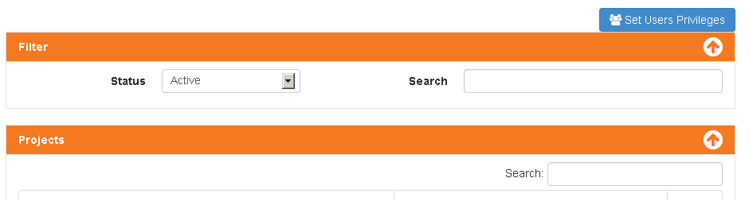
Principal page
On Principal Page you have filters, projects to inspect, and if you are BPMAdminTool_Project_Inspector_Admin button set users privileges

Slide 31
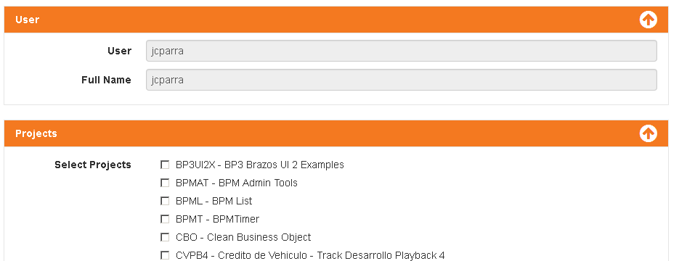
Set users privileges
As BPMAdminTool_Project_Inspector_Admin you can set a user to access as reader, check what projects a user can see and save.

Slide 32
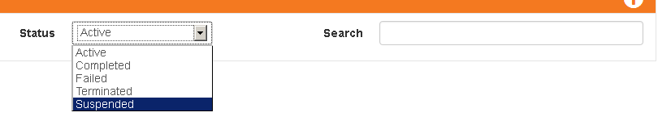
Filter before search
Before open a project filter by status, search field filter by Instance Name, BPD Instance ID and Snapshot Name.

Slide 33
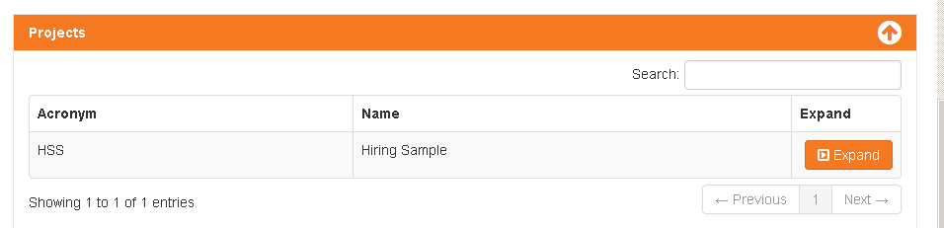
Open a Project
Remember you can’t see all projects, but only those one you get access.

Slide 34
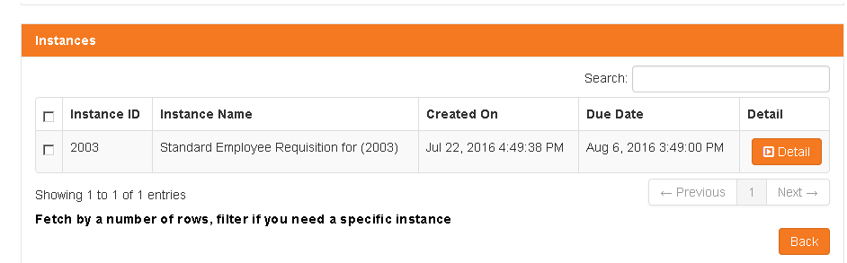
List of Instances
You can see details of that instance, resume if it was failed, dates name, and others values.

Slide 35
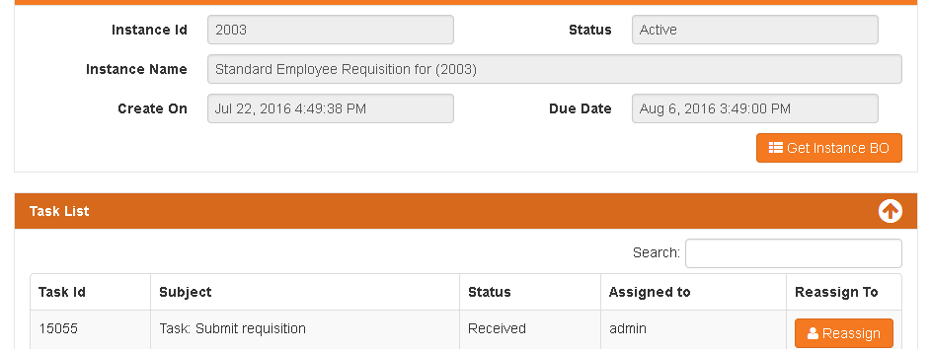
Instance Details
You can see detail info, as users, and if you have privileges, can see BO and reassign Task, Remember BO is instance level no task level. Also you can see Failure Message is instance is failed.

Slide 36
Vacation Manager
Allows delegation on vacations time, reassign task that are directly assigned to a user on vacations, to a delegated one.

Slide 37
Mode of Use
It is launched every hour o’clock so if a task arrives to a inbox on next clock our it will be reassigned to person is delegated.
Doesn´t control loops, so if you assign user1 as assumer from user 2, user 2 assumer from user 3, and user 3 assumer from user 1 on same date, it can works different as expected.

Slide 38
Authorization
To access this tool you have to be member of BPMAdmin_Vacation_Manager.

Slide 39
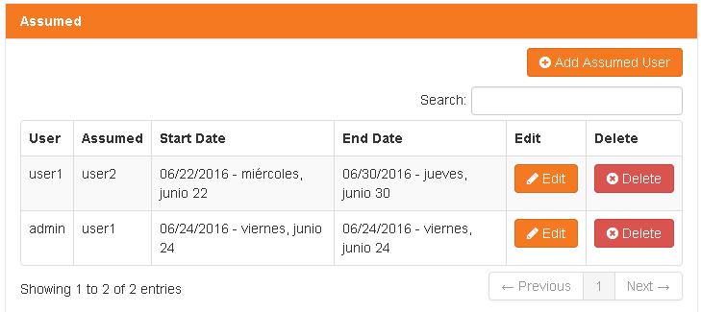
List of Vacation Assumers
On principal page you can see an modify vacations, if you need to run reasign outside schedule, click execute now button.

Slide 40
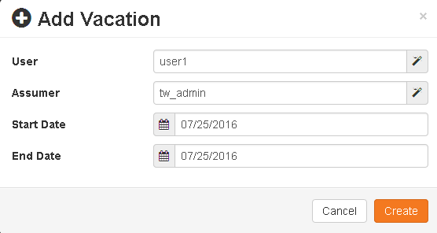
Add a vacation time
You can add a vacation time, user is person on vacation, assumer is delegated person, and date is vacation date.
It assumes full vacation day, from 00:00 until 23:59

Slide 41
Ticket Viewer
Some operations like export or import a snapshot requires wsadmin commands, and can take longer than expects, a ticket is generated to look output later

Slide 42
Mode of Use
Always tool gives you some ticket save it on a secure place, and search for it later to see results.
If missed, tickets are saved like TIKETID.log on logPath
If ticket is not generated, please check system out and see if there is a misconfigured path.

Slide 43
Authorization
To access this tool you have to be member ofBPMAdmin_Ticket_Viewer.

Slide 44
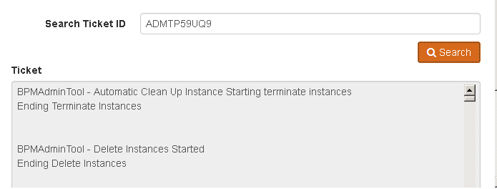
Search your ticket
Search your ticket id

Slide 45
Clean Up Enviroment
Some

Slide 46
Mode of Use
Always

Slide 47
Authorization
To access this tool you have to be member of BPMAdmin_CleanUp.

Slide 48
Search your ticket
Search your ticket id

